Slide 1
G2M Case Study
Virtual Internship – Yusuf Shamsi

Slide 2
Background/Introduction
XYZ is a private equity firm in US. Due to remarkable growth in the Cab Industry in last few years and multiple key players in the market, it is planning for an investment in Cab industry.
Objective : Provide actionable insights to help XYZ firm in identifying the right company for making investment.

Slide 3
Data Background
Data joining of Cab_Data.csv, Customer_ID.csv, Transaction_ID.csv, City.csv
Cab_Data.csv – this file includes details of transaction for 2 cab companies
Customer_ID.csv – this is a mapping table that contains a unique identifier which links the customer’s demographic details
Transaction_ID.csv – this is a mapping table that contains transaction to customer mapping and payment mode
City.csv – this file contains list of US cities, their population and number of cab users
22 Features (including 8 derived features)
Timeframe of the data: 2016-01-31 to 2018-12-31
Total data points: 395,392

Slide 4
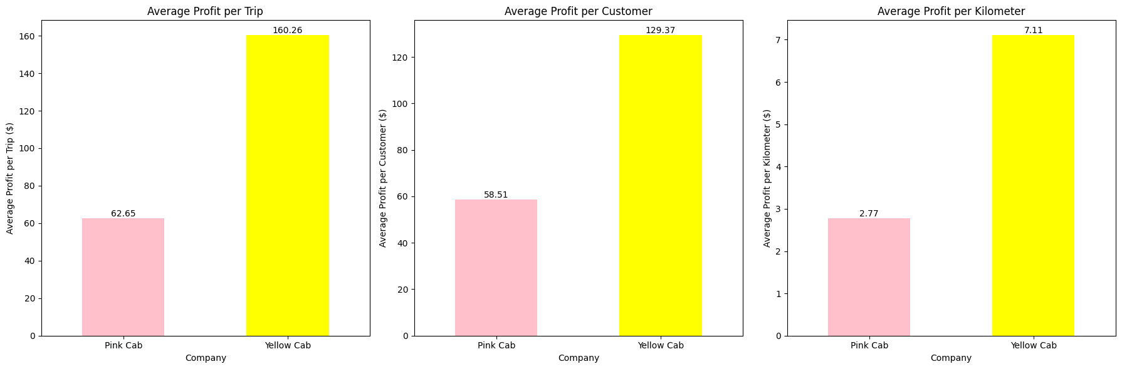
Profit Analysis
Overall the Yellow Cab company has a higher profit rate across all three metrics—per trip, per customer, and per kilometre—compared to Pink Cab.

Slide 5
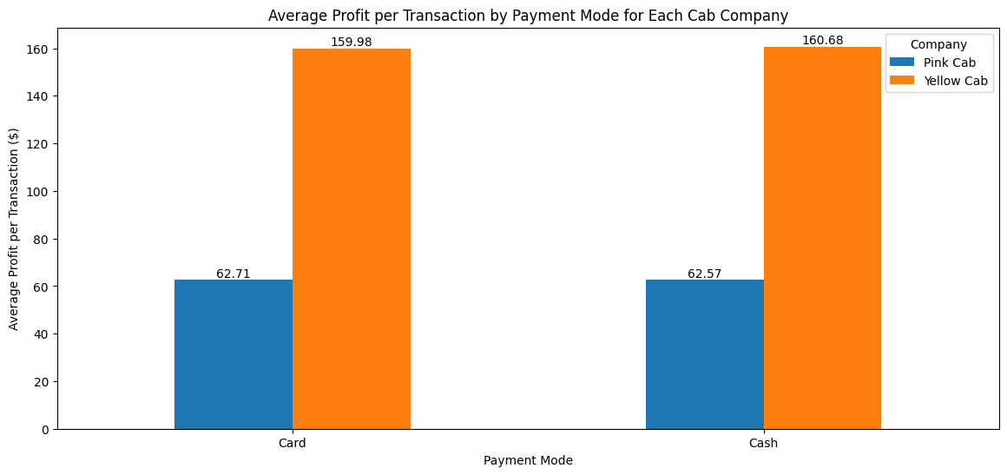
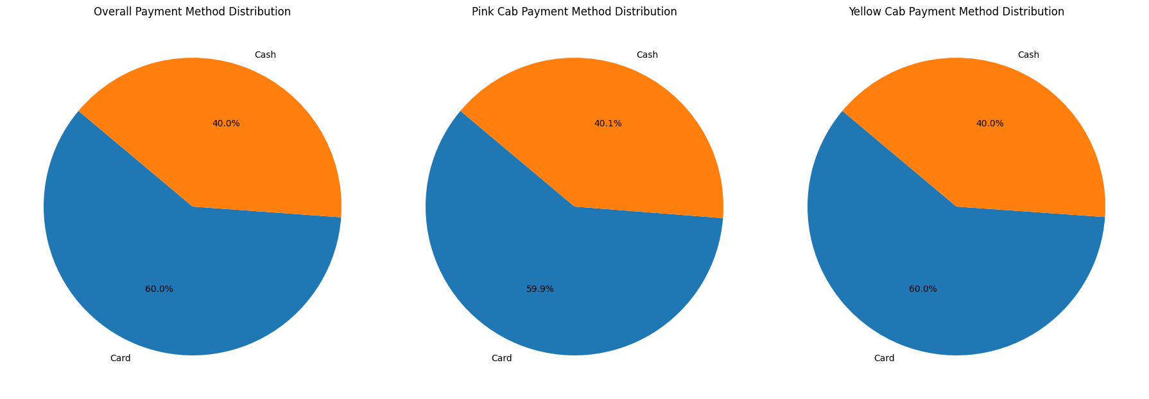
Payment Method Analysis
- Average Profit per Transaction: The average profit per transaction is relatively similar for both payment modes within each company. However, Yellow Cab's average profit per transaction is substantially higher than that of Pink Cab, regardless of the payment mode.
- Company Specific Trends: Both Pink Cab and Yellow Cab show higher total profits from card payments compared to cash, with around 60% of transactions made by card.

Slide 6
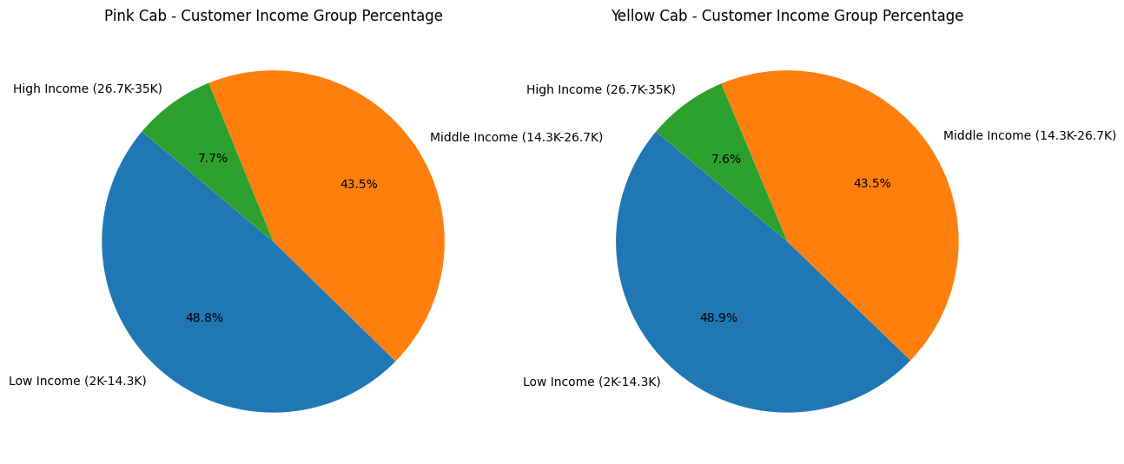
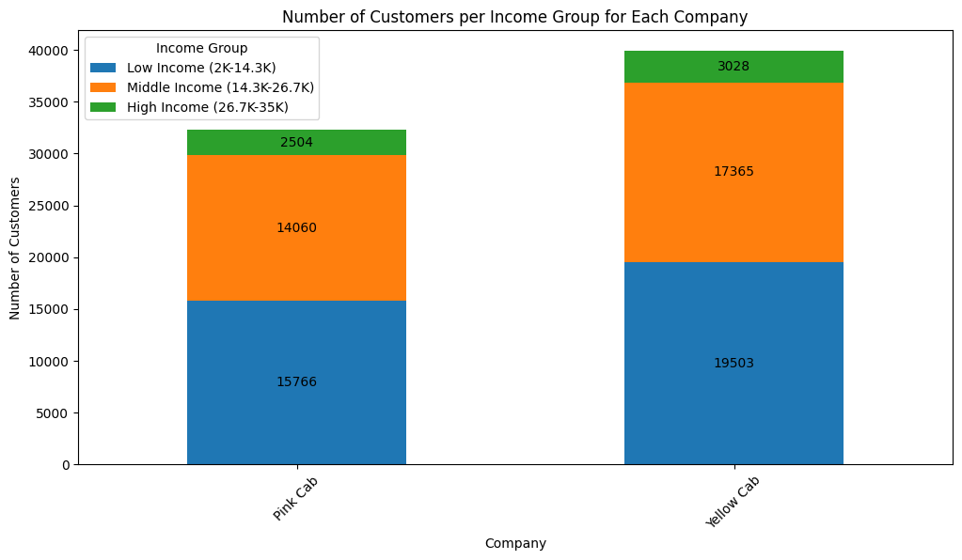
Customer Demographics: Income Group
Both companies have comparable distributions across the income groups, with the majority of customers in the low and middle-income brackets.
There is no significant difference in income group preference between Pink Cab and Yellow Cab. Yellow Cab has a higher number of rides across all income groups, reflecting its larger market share. The average income per user for each company is relatively similar as well.

Slide 7
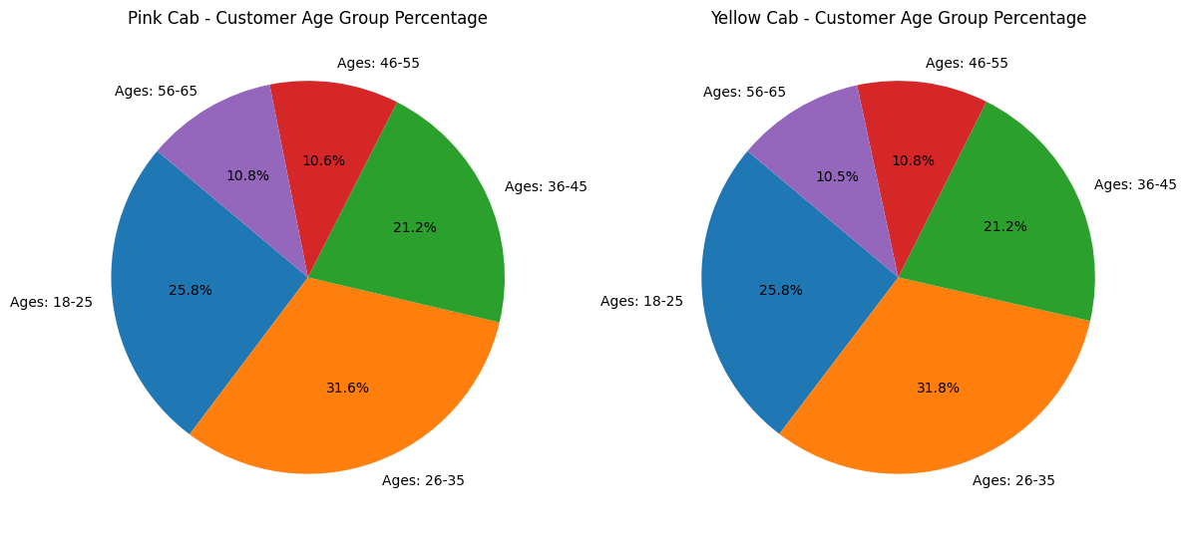
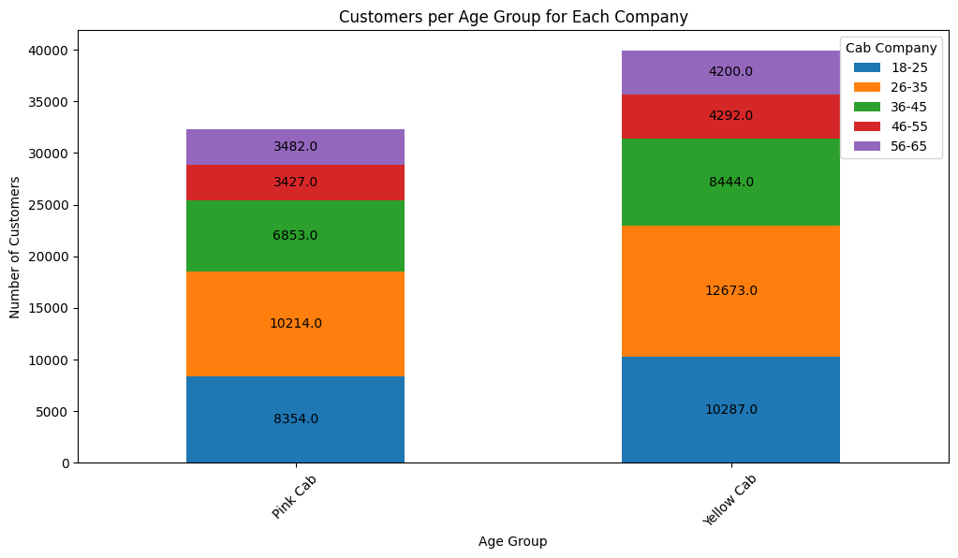
Customer Demographics: Age
The age distribution of the total number of customers in each company is similar: the highest percentages in the 26-35 age group, followed by the 18-25 and 36-45 age groups.
There is no distinct age group preference that significantly differentiates one company from the other. However, the total number of customers and trips are higher in the Yellow cab company.

Slide 8
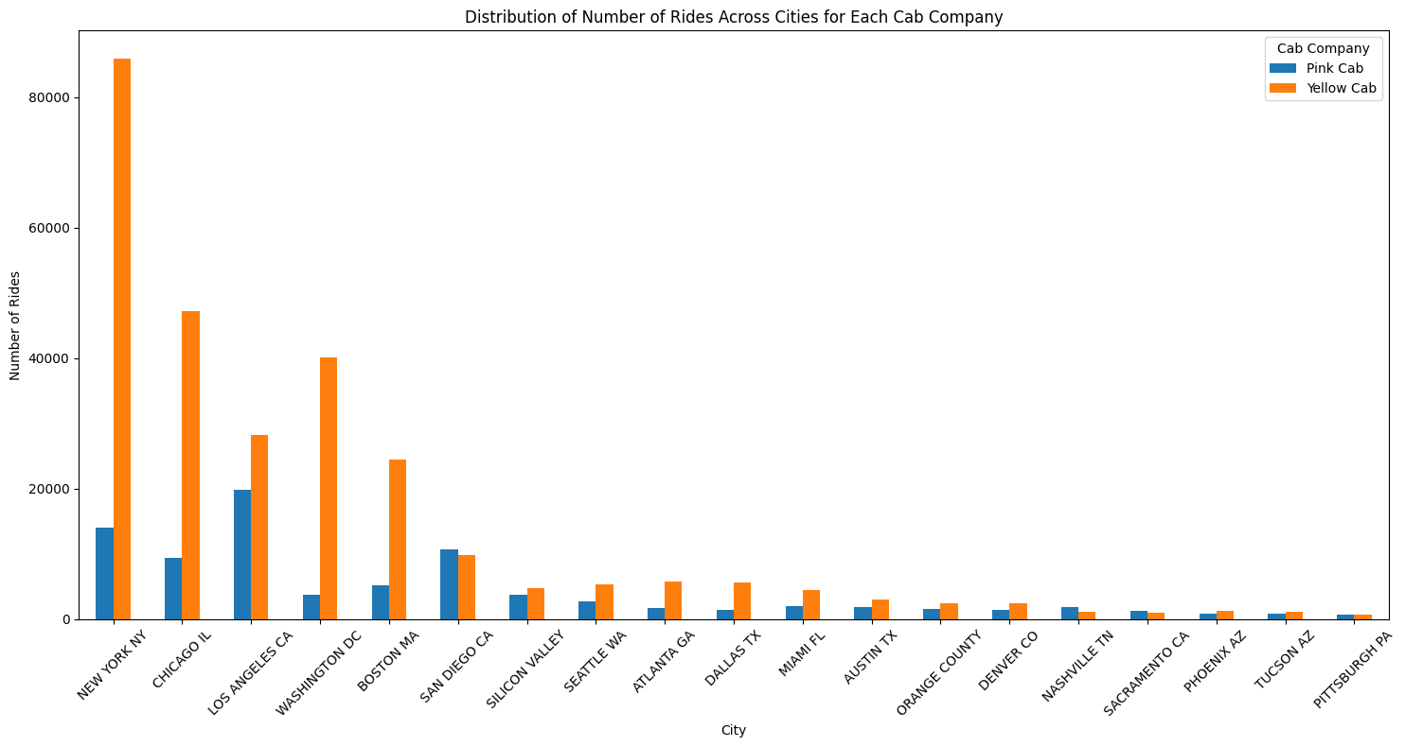
Trip Analysis: City Wise
Yellow Cab is the most popular company in the majority of cities, including Atlanta, Austin, Boston, Chicago, Dallas, Denver, Los Angeles, Miami, New York, Orange County, Phoenix, Seattle, Silicon Valley, Tucson, and Washington DC.
Pink Cab is more popular in a few cities: Nashville, Pittsburgh, Sacramento, and San Diego.

Slide 9
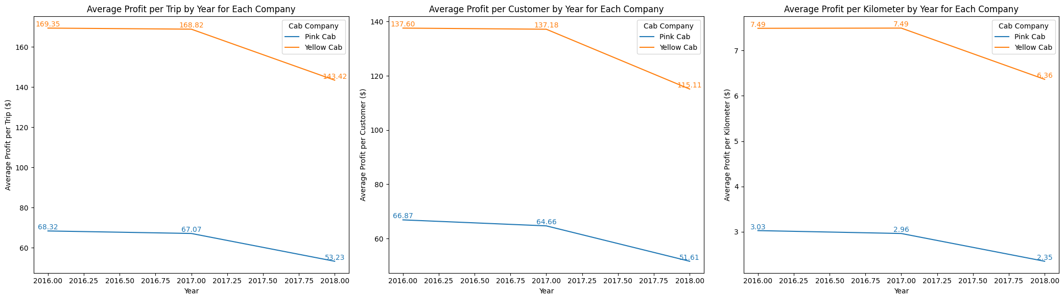
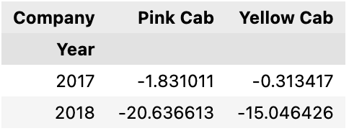
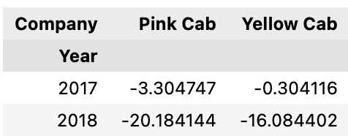
Time and Seasonality Profit Analysis
For both Pink Cab and Yellow Cab, 2016 was a peak year for average profit per trip and per customer, with a noticeable decline in the subsequent years.
In terms of average profit per kilometer, Pink Cab peaked in 2016, while Yellow Cab peaked in 2017.
The decline in profit metrics from 2017 to 2018 was more pronounced for Pink Cab compared to Yellow Cab across all categories.

Slide 10
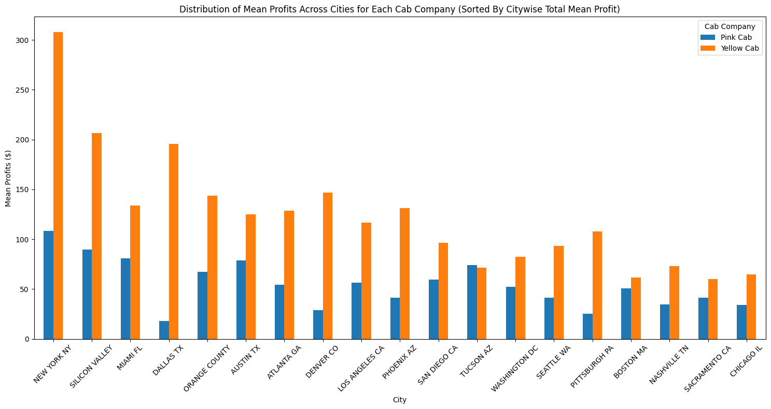
Company specific area distribution of mean profits
Profit varies by city, indicating that certain areas (cities) are likely to generate more profit for each company.
The top three areas that generated the most profit overall are New York City, Silicon Valley and Miami.
Yellow Cab tends to generate higher profits, both in total and on average, in these cities compared to Pink Cab.
Yellow Cab's mean profit trip is also consistently higher in these cities. The differences in profitability across cities highlight the impact of local market dynamics and the operational scale of each company in those areas.

Slide 11
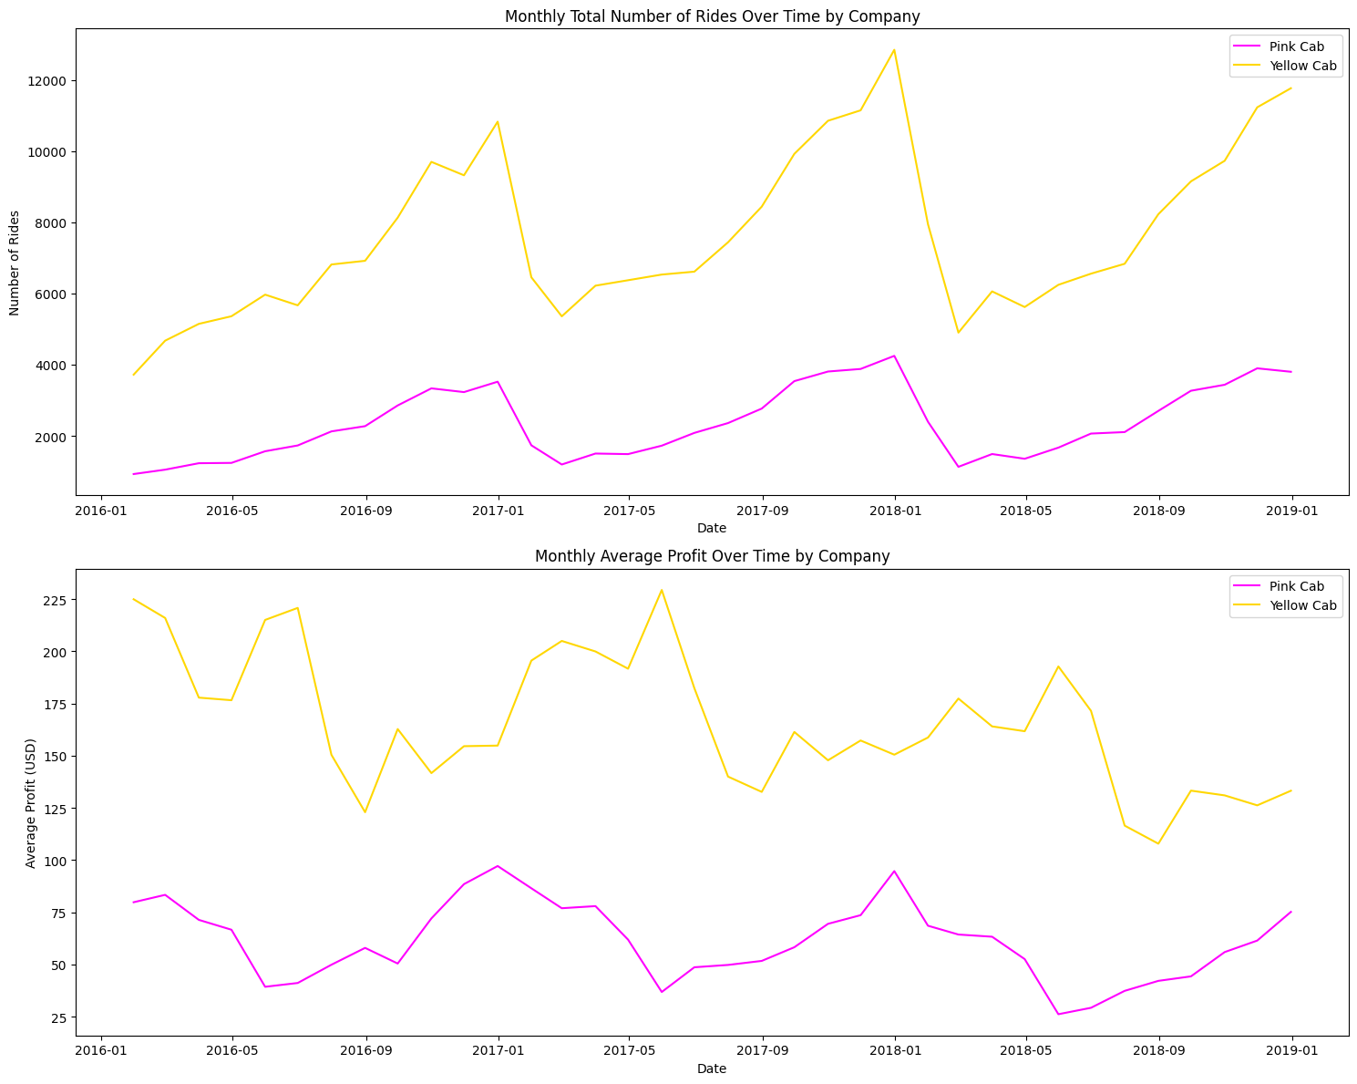
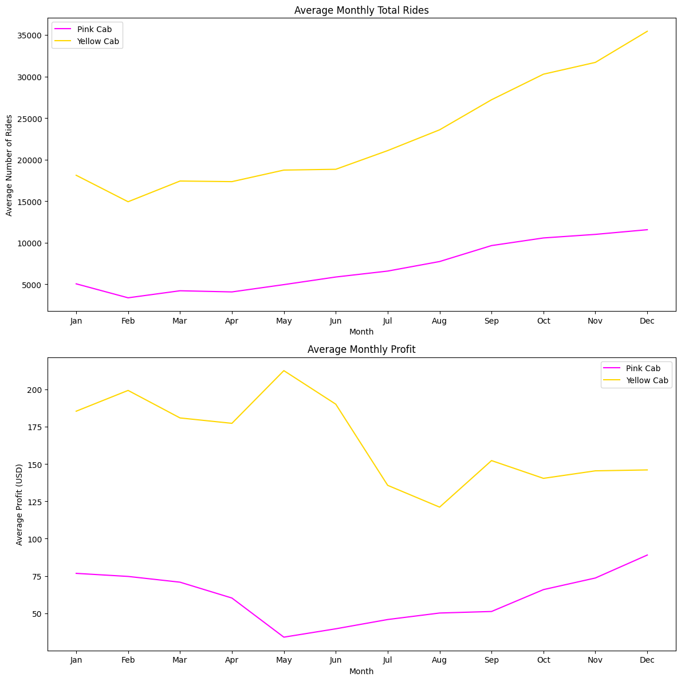
Time Series Analysis: Number of Rides
- Seasonal Variations: Both companies exhibit clear seasonal patterns in the number of rides. This suggests higher demand during certain times of the year.
- Company Comparison: Yellow Cab consistently shows a higher number of rides compared to Pink Cab throughout the period.
- Yearly Trends: There's a general fluctuation in the number of rides per year, but no clear increasing or decreasing trend is evident for either company over the years.
Pink Cab
- Peak Months: The highest number of rides typically occurs in the later months of the year, with a noticeable peak around December.
- Lowest Months: The rides tend to be lower in the early months, particularly around January and February.
Yellow Cab
- Peak Months: Similar to Pink Cab, Yellow Cab also experiences its highest ride numbers towards the end of the year, with a significant peak in December.
- Lowest Months: The lowest number of rides for Yellow Cab also falls in the early part of the year, with the lowest around January.

Slide 12
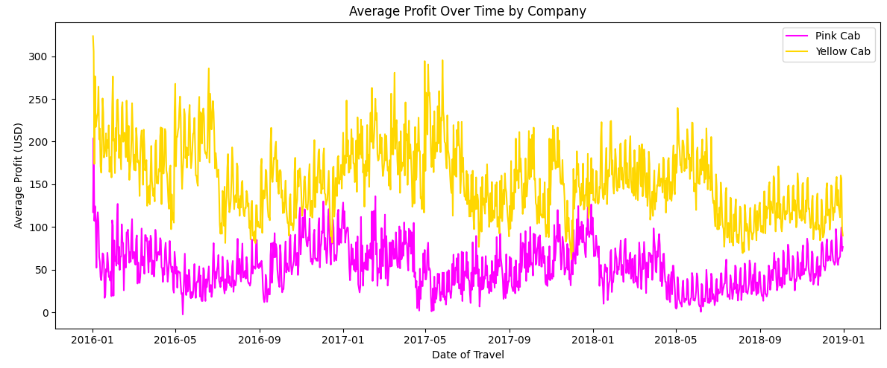
Time Series Analysis: Profit
Consistent Difference in Profit: Yellow Cab again consistently shows higher average profits than Pink Cab. This aligns with their higher number of rides.
Seasonal Profit Variations: Similar to the rides, there are seasonal variations in profit. However, these do not seem as pronounced as the ride count variations.
Stability in Profit: Despite fluctuations, the average profit for both companies remains relatively stable over the years, without a clear increasing or decreasing trend.

Slide 13
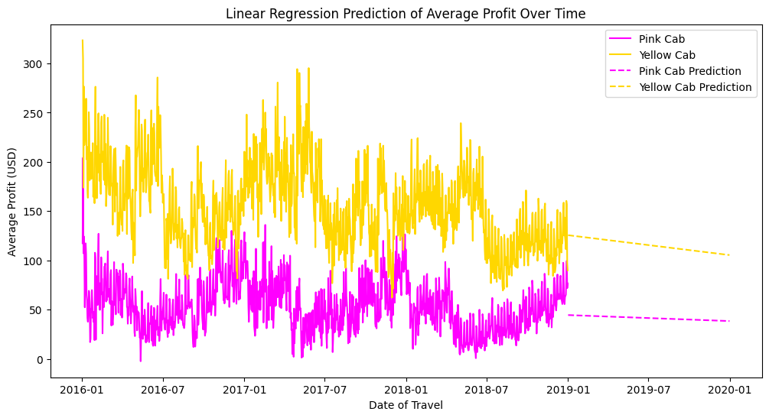
Prediction of future profit
Yellow Cab is likely to be more profitable than Pink Cab in the future, based on the average profit trends provided by the linear regression models.
The predicted average future profit for Pink Cab is approximately $41.38.
The predicted average future profit for Yellow Cab is approximately $115.47.

Slide 14
Recommendations
Profit rate: Yellow Cab has a higher profit rate across all three metrics—per trip, per customer, and per kilometer—compared to Pink Cab.
Market share of Yellow cab vs Pink cab: The market share for Yellow Cab and Pink Cab, based on the total number of rides, is as follows: Pink Cab: 23.57%, Yellow Cab: 76.43%. This indicates that Yellow Cab has a significantly larger market share in terms of the number of rides.
City Wise Popularity: Yellow Cab is the most popular company in the majority of cities, including Atlanta, Austin, Boston, Chicago, Dallas, Denver, Los Angeles, Miami, New York, Orange County, Phoenix, Seattle, Silicon Valley, Tucson, and Washington DC. Pink Cab is more popular in a few cities: Nashville, Pittsburgh, Sacramento, and San Diego.
Profit varies by city, indicating that certain areas (cities) are likely to generate more profit for each company. The top three areas that generated the most profit overall are New York City, Silicon Valley and Miami. Yellow Cab tends to generate higher profits, both in total and on average, in these cities compared to Pink Cab.
Age preferences - Age distribution of the total number of customers in each company is similar: the highest percentages in the 26-35 age group, followed by the 18-25 and 36-45 age groups. There is no distinct age group preference that significantly differentiates one company from the other. However, the total number of customers and trips are higher in the Yellow cab company.
Payments Preferences: Both companies show a higher preference for card payments over cash. Yellow Cab has a significantly higher number of transactions in both payment modes, aligning with its larger market share.
Gender Preferences: Both companies have a higher number of rides from male customers compared to female customers. Yellow Cab has a slightly higher percentage of male customers compared to Pink Cab.
Income ranges preferences: Both companies have comparable distributions across the income groups, with the majority of customers in the low and middle-income brackets (Overall 2K-26.7K)
Using a prediction which company is likely to make more profit in future - According to a regression based on Average Daily Data the Yellow Cab is more likely to be more profitable.
Based on this EDA and the hypothesis we recommend that XYZ invest in the Yellow Cab, due to current various factors addressed including promise in market share and predictions in profit in comparison to the alternative 'Pink Cab' company.*

